Slide 1
Community Presentation
October 31, 2018
Presented by
Jelynne LeBlanc Burley
President/Chief Executive Officer

Slide 2
The Center for Health Care Services
CHCS is one of 38 Local Mental Health Authorities in Texas providing treatment for:
Serious mental illness; Intellectual and Developmental Disabilities (IDD); Substance use disorders; Primary Care
Emphasis is on safety net services for the uninsured and underinsured in Bexar County/San Antonio area
In 2018, CHCS served 37,000 clients with just under one million individual services
Total budget in FY 2019 is $106.5 million
Over 1,100 employees providing service at 31 locations
2

Slide 3
Hope and Healing for Children and Adults
Integrated primary and behavioral health care
Psychiatric treatment for severe mental illness
Substance use disorder treatment programs
Individual and Group Counseling and Therapy
Medication management
Jail Diversion Initiatives
3

Slide 4
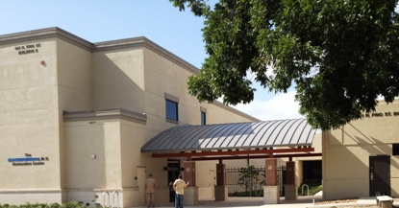
Smart Justice – San Antonio Style
Nationally Recognized Jail Diversion Programs at The Restoration Center
Crisis Care Center, open 24/7– law enforcement drops off clients and returns to duty, usually within 15 minutes (Opened in 2008)
Public Sobering and Detoxification
Minor Medical Clinic
Opioid Addiction Treatment Services
Crisis Intervention Training and Mobile Crisis Outreach Teams (MCOT)
Residential and Outpatient Substance Abuse Services (Mommies/NAS)
Specialty Courts
Integrated treatment programs for co-occurring mental health and substance use disorders
4

Slide 5
The South Texas Crisis Collaborative
Law Enforcement Navigation, a platform deployed by STCC, was developed after 12 area hospitals came together, defined the repeat consumer population with high acuity and contributed funding to assist with their health care delivery
The program was piloted in October 2017 and was estimated to assist 600 consumers monthly; as of September of 2018, 820 consumers per month are routed to appropriate care
Nix PES – expanded from 16 to 32 beds with a goal to serve as a decompression point for emergency departments (Sept. 2018)
Acute Care Station-SAFD, Haven for Hope and CentroMed partnering on a 9-1-1 intercept model to mitigate calls and create access to care; EMS transports are down 75% since launch in July, from 96 transports down to 54 transports in (July-Sept. 2018)
Crosspoint – 35 bed behavioral health diversion program providing 24/7 residential support with embedded outpatient treatment services for male population (Sept. 2018)
5

Slide 6
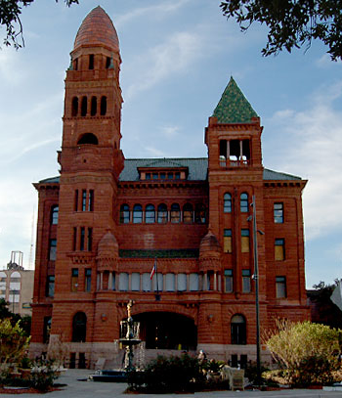
Specialty Courts funded by Bexar County
Specialty Courts Funded by Bexar County ($2.2 million)
Provides Assisted Outpatient Treatment for chronic mental illness
Court Ordered Treatment
Community Reintegration Program (active community supervision)
County Court at Law 12 (active misdemeanor supervision)
MIND Court
6

Slide 7
Specialty Courts funded by UHS
Specialty Courts Funded by University Health System ($1.2 million) for the Community Alternatives to Incarceration Program (CAIP):
Felony Drug Court
Esperanza (Solicitation Charges)
DWI
Misdemeanor Drug Court
Referrals from other courts:
DWI
Veterans
Federal and State Parole Departments
Bexar County Probation and Pretrial Services, Adult Detention Center
7

Slide 8
Additional Jail Diversion Opportunities
Through funding under Senate Bill 292, CHCS has added the following to its Crisis Continuum:
A 15 bed Crisis Stabilization Unit in partnership with Nix Health
Opened in July 2018
Currently at 97% utilization rate
Additional staffing at Central Magistration or Booking Facility for 24/7/365 coverage
Funding to staff a new treatment team for the justice involved community (FACT Team)
Additional fidelity training for the treatment team for non-justice involved individuals (ACT Team)
$3.24M awarded for 2018; $4.5M awarded for FY 2019
Total award for FY 18 and FY 19 = $7.74M
8

Slide 9
Jail Diversion Costs in Bexar County
Average cost per jail booking: $2,295 per person per incident
Average Cost to Incarcerate Pretrial Defendants with State Jail Charges: $3,245.00 per person per incident
Average Cost to Incarcerate Pretrial Defendants with Misdemeanor Charges: $18,113.00 per person per year
Average Cost to Incarcerate Pretrial Defendants with Felony Charges: $79,178.00 per person per year
Our Treatment Costs for Jail Diversion:
Specialty Courts funded by Bexar County
CHCS serves 687 unduplicated clients at an average daily cost of $16.95 per client
Specialty Courts funded by UHS
CHCS serves 568 unduplicated clients at an average daily cost of $8.45 per client
9

Slide 10
Cost Avoidance Data*
Public Inebriates Diverted from Detention Facilities
Total patients - 43,718
Total Cost Avoidance - $9,968,369
Injured Detainees Diverted from UHS ER
Total patients - 7,430
Total Cost Avoidance - $3,715,000
Mentally Ill Diverted from UHS ER
Total patients – 6,590
Total Cost Avoidance - $3,355,000
Mentally Ill Diverted from Magistration
Total patients – 6,461
Total Cost Avoidance - $1,425,092 *FY 2009-FY 2017
10

Slide 11
Outcomes
Since 2008, CHCS diversion programs have resulted in the following cost avoidance numbers:
City of San Antonio - $18,453,462
Bexar County – $78,287,016
That’s $96,740,478 in total cost avoidance for the city and county over 10 years!
More importantly, we’ve returned over 100,000 people back to their homes and families so they can live independent and productive lives
11

Slide 12
Questions and Answers
12

